Slide 1
Choosing the right NoSQL database
Juozas “Joe” Kaziukėnas
http://juokaz.com / juozas@juokaz.com / @juokaz

Slide 2

Who is this guy?
Juozas Kaziukėnas, Lithuanian
You can call me Joe
~4 years in Edinburgh, UK
CEO of Web Species Ltd
Occasional open source developer
Conferences speaker
More info in http://juokaz.com
Tweet me @juokaz

Slide 3
Do not throw away MySQL

Slide 4
Don’t throw away MySQL
Reliability
Relational model
Transactions
SQL
Integration

Slide 5
ACID
Atomicity
Consistency
Isolation
Durability

Slide 6
Problems with RDBMS
Vertical scalability
Hardware (memory) limits
Horizontal scalability
Joins
Transactions
Consistency is a major bottleneck

Slide 7
CAP theorem
Consistency
Availability
Partition tolerance
* http://en.wikipedia.org/wiki/CAP_theorem

Slide 8
NoSQL birth

Slide 9
NoSQL
Data driven projects
A lot of data
Real-time analysis
Google BigTable and Amazon Dynamo

Slide 10
Relaxed ACID
Acid:
Atomicity
Consistency
Isolation
Durability
Hard to implement in distributed systems
Eventual consistency

Slide 11
Schema
Schema-less
Types
Key Value
Dynamo, Membase, Riak, Redis
Document
MongoDB and CouchDB
Graph
Neo4j, FlockDB
Column
Big Table, Cassandra, Hbase

Slide 12
Business defines architecture

Slide 13
Business defines architecture
Understand
Business model
Use cases
Size
Requirements
Do not over-engineer, it will fail anyway
Do not lock-in

Slide 14
Access patterns
Dynamic queries
Index data
Map/Reduce
Key lookups

Slide 15
Map/Reduce
Created by Google
Process data using mappers and reducers
Can be distributed on any amount of machines
Popular to use with Hadoop

Slide 16
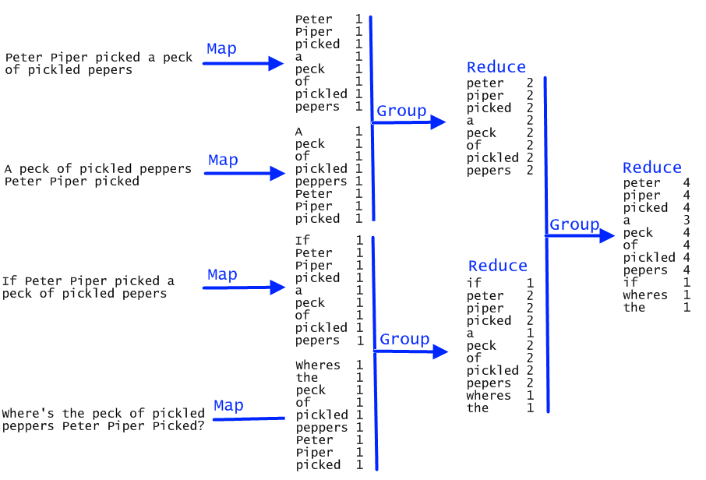

Slide 17
If you don’t need secondary-indices anything will work

Slide 18
You will fail
Distributed systems are tricky
Databases are buggy…
Foursquare, Tumblr, Twitter and more publicly failed
Outage
Data loss
Consistency problem

Slide 19
Performance is not your goal*

Slide 20
Choosing

Slide 21
NoSQL vs RDBMS
NoSQL > SQL
NoSQL < SQL
Horizontal scalability
High write OR read throughput
Stores any data
No partial reads
No security
No relational model
Only stores data, no reporting, aggregating

Slide 22
Pick
Distribution model
Dynamo like
Master-Master
Master-Slave
Query model
Map/Reduce
Dynamic queries
Disk structure
How database is persisted on a disk

Slide 23
Redis
In-memory database (needs to fit in memory*)
Eventual consistency in disk
Master-slave replication
Key-value, but also sets, lists and hashes
Supports transactions
Good for expiring and/or rapidly changing data

Slide 24
MongoDB
Master/Slave replication
Sharding
Dynamic queries
Using JavaScript expressions
Update-in-place with atomic operations
Can store files
For anything MySQL would be used for, but schema-less is required
Used to be unreliable on a single machine

Slide 25
CouchDB
Bi-directional replication. Master-master
Versioning and conflict detection
Always consistent
Needs compacting, not good for rapid changing data
Map/Reduce as query mechanism
Real-time data updates feed (_changes)
Document validation
Best for offline systems. Great for content stores

Slide 26
Cassandra
Faster writes than reads
Query by column
Secondary indices
Map/reduce possible with Hadoop
Complex, Java system
Used to store a lot of data

Slide 27
HBase
Map/Reduce with Hadoop
Random access
Real-time read/write access

Slide 28
Neo4j
Graph database
Master-slave
Path finding
Optimized for reads
For complicated interconnected data

Slide 29
Database will fail

Slide 30
Database will fail
Measure
Memory
Disk I/O
CPU utilization
Don’t try to make a database do things it wasn’t designed for
Create a non-relational model
Denormalize

Slide 31
Thank you!
Keep in touch
http://juokaz.com
juozas@juokaz.com
twitter: @juokaz

